Slide 1
Programming
Numbers, strings and arrays

Slide 2
Overview
Numbers’ presentation:
  Basic data types
  Classes
Stringd
Arrays

Slide 3
Basic data types
We already covered the subject:
  int, byte, short, long
  double, float
  char
  boolean

Slide 4
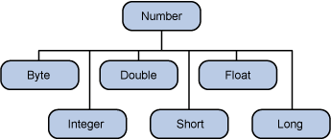
Class java.lang.Number
Extended from Number:
  Byte
  Short
  Integer
  Long
  Float
  Double
Classes instead of basic data types ➔
ovijanje (wrapping)

Slide 5
Why classes?
3 reasens for class usage instead of basyc data types
  When the parameter of a methos is an object
  The need for MIN_VALUE in MAX_VALUE
  The usage od methods (metod) for translation/transformation between basic data types
Example:
Integer x, y;
x = 12;
y = 15;
System.out.println(x+y);

Slide 6
Methods pf the “number” classes
Methods of the Number class and subclasses:
http://java.sun.com/j2se/1.5.0/docs/api/java/lang/Number.html
Why are they useful?
  … homework …

Slide 7
Characters – char and Character
Examples:
char ch = 'a';
char uniChar = '\u039A';
// Unicode reppresentation of the Greek omega
char[] charArray ={ 'a', 'b', 'c', 'd', 'e' };
// array of characters
Character ch = new Character('a');
Character ch = 'a';
// basic type 'a' is wrapped into and object of the type Character
Character test(Character c) {...}
// object of the type Character is parameter of the method and the type of the result of the method
char c = test('x');
// wrapped and unwrapped

Slide 8
Methods of the class Character
  boolean isLetter(char ch)
  boolean isDigit(char ch)
  boolean isWhiteSpace(char ch)
  boolean isUpperCase(char ch)
  boolean isLowerCase(char ch)
  char toUpperCase(char ch)
  char toLowerCase(char ch)
  toString(char ch)
What are special characters? (\t,\b,\n,\r,\f,\’,\”,\\)

Slide 9
Strings - definition
Examples of the defintions of strings (String):
String greeting = "Hello world!";
char[] helloArray = { 'h', 'e', 'l', 'l', 'o', '.'};
String helloString = new String(helloArray);
System.out.println(helloString);

Slide 10
Strings – length, concatenation
How do we establish the length of a string?
String palindrome = "Dot saw I was Tod";
int len = palindrome.length();
How to concatenate strings?
string1.concat(string2);
"My name is ".concat("Rumplestiltskin");
"Hello," + " world" + "!"

Slide 11
Strings ++
What can we do with strings?
  Convert them into numbers and vice-versa
  Process characters in strings:
    Find characters, substrings
    Change case
    Change characters, substrings, …
http://java.sun.com/docs/books/tutorial/java/data/manipstrings.html
http://java.sun.com/j2se/1.5.0/docs/api/java/lang/String.html

Slide 12
Arrays
Declaration, initialization and access:
class ArrayDemo {
public static void main(String[] args) {
int[] anArray; // declaration of an array of integer numbers
anArray = new int[10]; // memory allocation for 10 integers
anArray[0] = 100; // initialization of the 1. element
anArray[1] = 200; // initialization of the 2. element
anArray[2] = 300; // ...
...
…all in one:
int[] anArray = {100, 200, 300, 400, 500, 600};

Slide 13
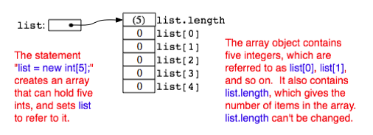
More about arrays … (1)
In the memory:

Slide 14
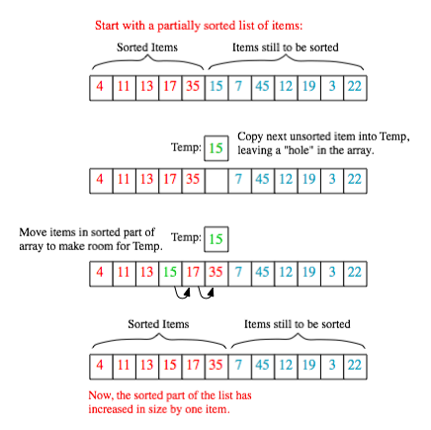
More about arrays … (2)
Arrays for search and sorting

Slide 15
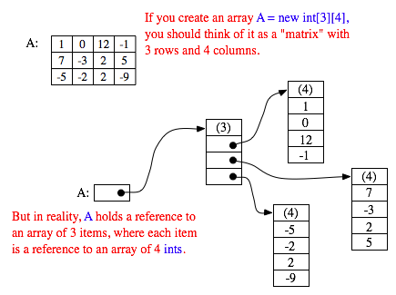
More about arrays … (3)
Multi-dimensional arrays
int[][] A = { { 1, 0, 12, -1 },
{ 7, -3, 2, 5 },
{ -5, -2, 2, -9 }
};
int[][] A = new int[3][4];
for (int row = 0; row < 3; row++) {
for (int column = 0; column < 4; column++) {
A[row][column] = 0;
}
}

Slide 16
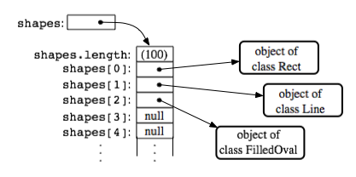
More about arrays … (4)
Dynamic arrays:
  Variable-length arrays
  “Half-empty” arrays
  Special objects (classes) :
    ArrayList
    Vector
  Let us write a class
public static double average( double[] numbers ) {
double sum; // sum of all parameters
double average; // average of all parameters
sum = 0;
for (int i = 0; i < numbers.length; i++) {
sum = sum + numbers[i];
// add a parameter
}
average = sum / numbers.length;
return average;
}

Slide 17
Summary
What have we smo izvedeli?
  About “number classes”, wrapping of basic data types, …
  About characters and and strings
  About arrays and possible usages

Slide 18
Resources
http://java.sun.com/docs/books/tutorial/java/data/index.html
http://java.sun.com/docs/books/tutorial/java/nutsandbolts/arrays.html
http://math.hws.edu/javanotes/c7/index.html

Slide 19
Homework
Remember the homework from 123 minutes before?

